Slide 1
Cruise into Kindergarten - Initial Survey Results
Fall, 2014

Slide 2
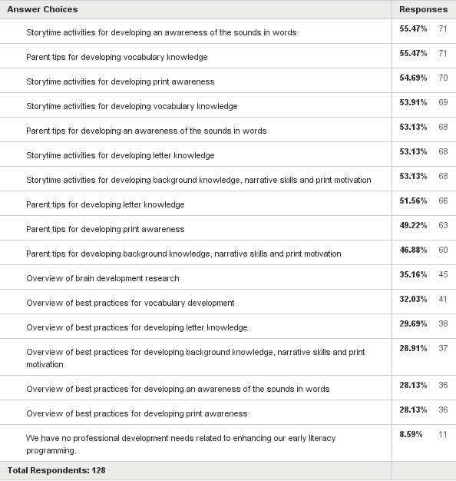
Q2: Which of the following areas represents a professional development need for enhancing programming at your library? (Check all that apply.)
Answered: 128 Skipped: 4

Slide 3
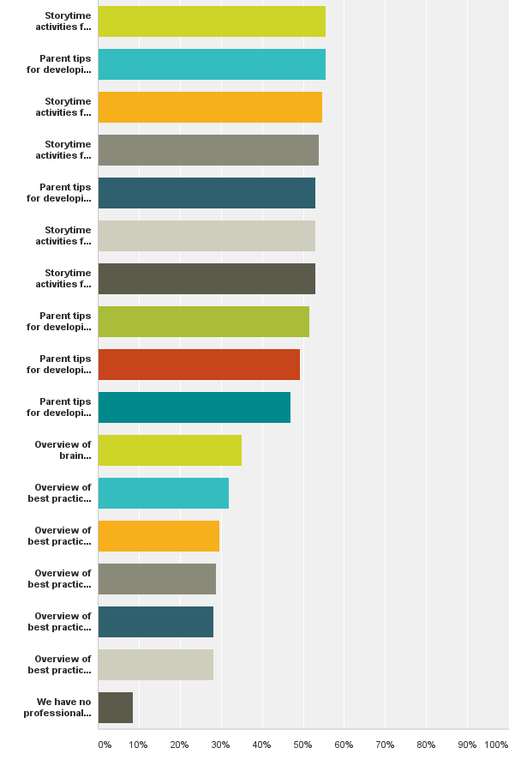
Q2: Which of the following areas represents a professional development need for enhancing programming at your library? (Check all that apply.)
Answered: 128 Skipped: 4

Slide 4
Comments (14)
I think it is important to review this idea often-- my last review/conference was 5 or 6 years ago.
I'm sure we do incorporate some of these practices during storytime but not in any organized way.
I am coming from an early childhood educator background but would appreciate tips for sharing with parents and am always interested in improving my storytimes.
We are not educators. We need to know WHY before HOW.
We have done quite a bit of professional development on these early literacy topics; however, ways to support parents as their children start reading would be great.
Actually, what has been asked for mostly are classes for parents to learn the best apps to use on their devices.
All of these, really, but an overview of each concept would allow us to develop activities in our own context.
If marketing knowledge is a professional need; we probably need better marketing to attract more people to the program.

Slide 5
Comments (continued)
9. Always open to new ideas for storytimes
10. Tips by age group and how to run storytime for each age group
11. New staff may need to attend workshops on these aspects.
12. Beyond the written word and book format, the inclusion of technology that supports
the 6 pre-reading skills would be welcome.
13. We are always interested in incorporating new research/ideas into our storytime
programs!
14. All would be helpful but not specific need.

Slide 6
Q3: How familiar are you with Every Child Ready to Read (ECRR)?
Answered: 132 Skipped: 0

Slide 7
Comments (5)
Our library did purchase the Very Ready Reading Program for Infant story times as that was my weak area, but we did not purchase the other curriculum due to my background strengths and limited funding. I did look at the ECRR curriculum at a Family Place refresher at Penn State fall of 2013.
Have used materials to teach CE classes.
I would like to learn more about this initiative.
I present the program 2-3 times a year at the library and other sites.
Getting more familiar with ECRR2.

Slide 8
Q4: Which of the following statements about ECRR applies to your setting? (Check all that apply.)
Answered: 129 Skipped: 3

Slide 9
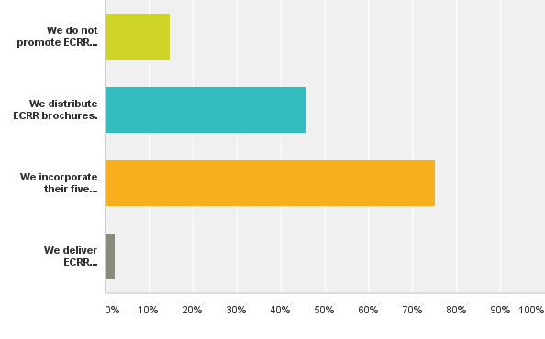
Q4: Which of the following statements about ECRR applies to your setting? (Check all that apply.)
Answered: 129 Skipped: 3
14.73%
19 responses
45.74%
59 responses
75.19%
97 responses
2.33%
3 responses

Slide 10
Comments (8)
Working toward workshops!
Storytimes could benefit from ideas for including writing.
I have used talking, singing, reading and playing in storytime, but not writing.
Presently, we do not incorporate writing in our storytimes.
We incorporate a combination of the six early literacy skills and the five practices into our storytimes.
Although I am not familiar with the acronym, we usually cover all but singing and writing in storytime.
We incorporate ECRR into our programs.
This will become a priority in 2015; working in tandem with Success By 6, United Way and our countywide 1000 Books grant.

Slide 11
Q5: How familiar are you with the Science, Technology, Engineering and Mathematics (STEM) education initiative as it relates to early childhood programming?
Answered: 130 Skipped: 2

Slide 12
Comments (3)
We do not really have a workspace for hands-on STEM projects for early childhood storytimes.
Definitely need to learn more.
Although setting high standards for all to strive for is a good idea, I hope you won't be as stringent with a library's part-time, low-wage, no-ed. beyond-high-school storytime leader's work as you would a professional teacher's.

Slide 13
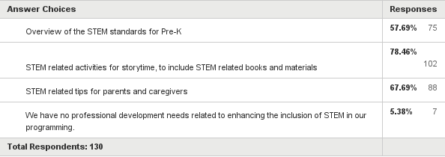
Q6: Which of the following areas represents a professional development need for enhancing programming at your library? (Check all that apply.)
Answered: 130 Skipped: 2

Slide 14
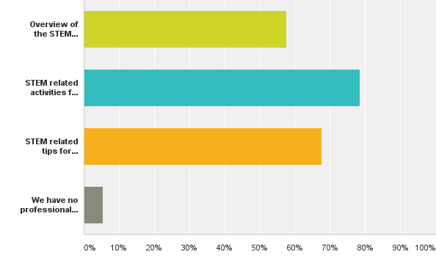
Q6: Which of the following areas represents a professional development need for enhancing programming at your library? (Check all that apply.)
Answered: 130 Skipped: 2
57.69%
75 responses
78.46%
102 responses
67.69%
88 responses
5.38%
7 responses

Slide 15
Comments (5)
Our library is the process of extending Stem and are renovating for this purpose.
One should never stop learning new ideas.
Although familiar with this concept any addition information would be appreciated. I do use a variety of books both Fic and NF and try to do movement activities that include a variety of modes. Our summer reading program curriculum has many ideas for including STEM activities especially for the elementary level.
We have included iPads in our storytimes as a way to model how to use technology with young children. We have used NAEYC's statement on using technology with young children as a basis. We also include nonfiction texts and counting and other math and science concepts into our storytimes.
We are always glad for more information relating to Pre-K.

Slide 16
Q7: Which of the following best describes your position on having toys and games in the library?
Answered: 132 Skipped: 0

Slide 17
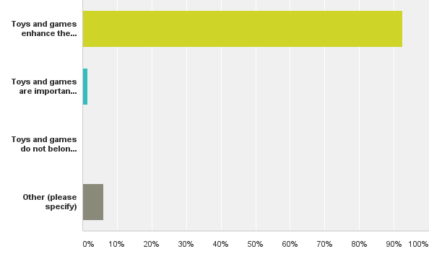
Q7: Which of the following best describes your position on having toys and games in the library?
Answered: 132 Skipped: 0
92.42%
122 responses
1.52%
2 responses
6.06%
8 responses

Slide 18
Other Responses (8)
I always set toys out at the end of my Toddler Time, which the parents and children really enjoy. We only have one toy - a box of blocks - sitting out for use throughout the day. Having worked in a library where there were lots of toys available all day, the staff had to spend lots of time each day cleaning up the toys even though there were signs out asking parents/children to clean up. So, my view is somewhere between the first and second choice.
We have incorporated toys and puzzles in our library children's room that are available at all times due to the Family Place Grant. For story times my practice is to keep their focused attention at the beginning for the stories and songs and save toys, games and other large motor activities like the parachute for the end of typical story time.
a blessing and a bane.....
Our children's room is not always staffed. Toys have gotten ruined and or left thrown all over the children's room.
The use of Magna-tiles as an example invigorates multi-age play at our library and encourages cooperative learning at all times.

Slide 19
Other Responses (continued)
6. Toys & games are fine & can be a great learning experience. However NO ONE (adult or child) has ever learned to put games away at our library, so we do not have them out loose and only use the in a controlled situation where staff knows they will be responsible for pick-up.
7. Toys & games enhance the library setting and, during library story time, brought out at the end unless are part of the program.
8. Toys and games enhance the library setting for children and families when played with properly and under supervision.

Slide 20
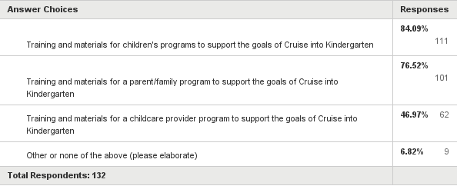
Q8: Based on your staffing and the needs of your community, which of the following opportunities/resources would be helpful? (Check all that apply.)
Answered: 132 Skipped: 0

Slide 21
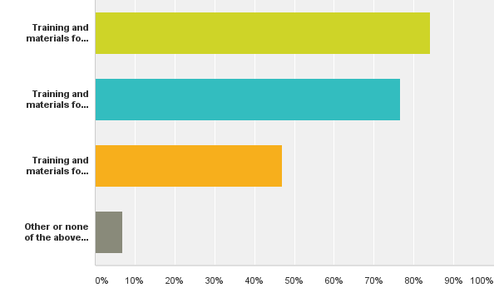
Q8: Based on your staffing and the needs of your community, which of the following opportunities/resources would be helpful? (Check all that apply.)
Answered: 132 Skipped: 0
84.09%
111 responses
76.52%
101 responses
46.97%
62 responses
6.82%
9 responses

Slide 22
Other Responses (9)
I would love to receive material to know how to promote a program like this in our library for the community!
I am an Early Childhood Educator in a Children's Librarian position, so I am well aware of all of these things. However, having a district wide workshop to refresh these areas would be most helpful for those not as aware.
Something very parent-friendly, that they will sit still for!
I would be interested in a workshop on classroom management, because sometime implementing new learning objective disrupts the flow of storytime. Families with children of all ages come to storytime even if the storytime is an age specific storytime and I would like to find a way to keep the peace during storytime while trying to "teach" these new learning objectives during storytime.
As a member of our School District's Pre-K transition team, we all work together to provide many activities for our transitioning kindergartens. Anything I do in my role is in total cooperation with our school district. It is important that the public library be seen in partnership with the school district, not as an entity doing its own thing.

Slide 23
Other Responses (continued)
6. No staffing available for training.
7. Including Head Start teachers in the "childcare provider program.”
8. We currently provide kindergarten readiness programs.
9. None of the above.

Slide 24
Conclusions & Implications
Respondents across the state want more early literacy parent tips and activities for their storytimes.
There is some need for a refresher of the research base on brain development and best practices for early literacy development.
There is some need for tips on behavior management during programming, particularly multi-age programming.
There is some need for marketing and technology tips related to programming efforts.
The majority of respondents are familiar with ECRR and incorporate the five practices into storytimes.
Less than half of the respondents are distributing ECRR brochures to their patrons.
ECRR workshops are being delivered on a limited basis across the state.
There is some need for tips and activities for incorporating writing into storytimes.

Slide 25
Conclusions & Implications
9. The majority of respondents across the state are familiar with the STEM initiative as it relates to programming.
10. The majority of respondents across the state want more professional development on STEM programming, with over half expressing a need for a review of the standards.
11.Almost all respondents selected that toys and games enhance the library setting, though the need for clean-up and management tips was expressed in the comments.
12.The majority of respondents across the state selected that training and materials for children’s programming related to the Cruise initiative would be the most helpful, followed by a parent/family program.
13. About half of the respondents indicated that training and materials for a childcare provider program would be helpful.
14.Staffing related to delivering programs is an issue for some of the libraries responding.

Slide 26
Next Steps & Recommendations
Share survey results and implications with the steering committee to examine statewide data for greatest needs.
Decide how each identified need will be addressed; through the website, email distribution, face-to-face trainings, and so on.
Form sub-committees to develop an outcome driven plan for addressing the identified needs.
Develop timelines for the highest priorities with goals for the next steering committee meeting.
Use county specific data to target resources.

Slide 27
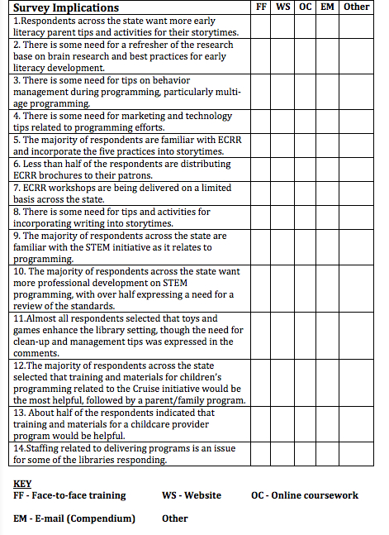

Slide 28
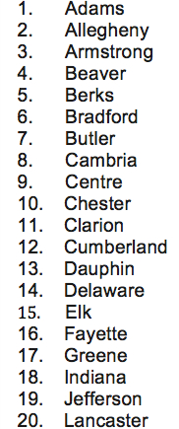
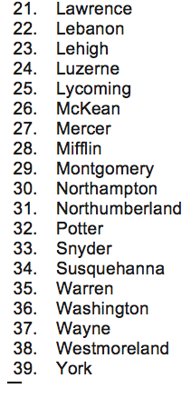
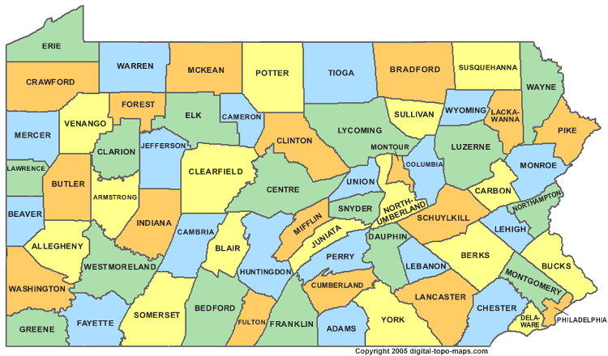
County Specific Data
Thirty-nine counties represented:

